Slide 1
Testing, Code Coverage, and Continuous Integration
ATPESC 2018
Jared O’Neal Mathematics and Computer Science Division
Argonne National Laboratory
Q Center, St. Charles, IL (USA) July 29 – August 10, 2018

Slide 2
Why is testing important?
Therac-25 computer-controlled radiation therapy machine
Minimal software testing
System administers radiation in improper setup
Unlucky patients were struck with approximately 100 times the intended dose
Recalled after six accidents resulting in serious injury
Race condition in the code went undetected
Leveson & Turner, “An Investigation of the Therac-25 Accidents”. IEEE (1993).
Notes:
SKIP: Talk is too long if I discuss this.
Example is extreme, but also SW if from an extreme SW class - Life-Critical System.
Minimal documentation regarding specifications and test planning.
Little unit and SW testing. Main fallback was on integrated system testing. It appears that testing was really more just “exercising” or using the system.
Turntable needed to be in correct position to allow patients to be radiated appropriately. For this machine, the SW was used to do safety check of the turntable position that setup correct position instead of HW interlocks. Patients could be radiated with the turntable in an invalid position.

Slide 3
Why is testing important?
Ariane 5 Launch Vehicle
Launched to lift heavy payloads into low Earth orbit
Initial rocket driven off course, started to disintegrate, and destroyed with 40 seconds of launch
SW shutdown when 64bit floating-point to 16bit int overflowed
Used directly SW from Ariane 4 - overflow physically impossible
Conversion never tested
Bashar Nuseibah, “Ariane 5: who dunnit?”. IEEE Software (1997).
http://iansommerville.com/software-engineering-book/case-studies/ariane5/
Notes:
SKIP: Talk is too long if I discuss this.
Example is still extreme, but SW if from a similar SW class - Mission-Critical System.
Failure was in SW of inertial navigation system.
Followed highly successful Ariane 4.
They followed good SW engineering practices and made reasonable decisions.
They reused SW from Ariane 4
They chose to avoid overflow exception tests in this case to minimize load of processor
Issues:
The Ariane 4 was much lighter/weaker and could never achieve the horizontal velocities necessary to overflow this conversion. Therefore, no error checking was reasonable
Speculation: No experts involved in decision making process to point out that Ariane 5 was stronger
SW was replaced by ground-based SW and therefore not needed.
While SW was the final failure and testing could have caught this and should have been done, in reality this failure is more strongly related to a system-level failure.
This is similar to scientific SW development when you consider working with reusing code originally intended for one use, combining code, or using third party code/library. How do you make certain that the assumptions made on both sides of the interface are correct and stay correct?

Slide 4
Why is testing important?
Protein structures in scientific software
Inherited data analysis code interchanged two data columns
inverted electron-density map
incorrect protein structure
Retracted 5 publications
One was cited 364 times
Many papers and grant applications conflicting with flawed results were rejected
Others based their research on incorrect results
Greg Miller, “A Scientist’s Nightmare: Software Problem Leads to Five Retractions”. Science (2006).
Notes:
SKIP: Talk is too long if I discuss this.
Extreme example that is immediately relatable - Geoffrey Chang. Crystallography for pharmaceutical research.
How does Scientific SW compare with Life- and Mission-Critical SW classes?
Error was in homemade analysis code that he had inherited from another lab.
Only 10 lines of code that had the problem. Didn’t question the quality of the SW at the time. Now he does.
https://www.the-scientist.com/?articles.view/articleNo/24647/title/Retractions-unsettle-structural-bio/

Slide 5
How common are bugs?
Programs do not acquire bugs as people acquire germs,
by hanging around other buggy programs.
Programmers must insert them.
- Harlan Mills
Industry average for delivered software
1-25 errors per 1000 lines of code
Microsoft Applications Division
10-20 defects per 1000 lines of code during in-house testing
1 defect per 2000 lines of code in released product
Steven McConnell, “Code Complete”. Second Edition (2004).
Notes:
The main point of the quote is that bugs just don’t happen. They are the result of how programmers and designers think and work. Therefore, why not put effort into preventing bugs from being put into the code?

Slide 6
Avoid debugging
Debugging is twice as hard as writing the code in the first place. Therefore, if you write the code as cleverly as possible, you are,
by definition, not smart enough to debug it.
- Brian Kernighan
Upfront effort can lead to clean code
Integrated tests encode result of time and effort
Integrated tests can ease debugging
Notes:
The previous quote is a lead in to this one. We want to avoid putting bugs into code. How do we do it?
While intent of quote is different, it still helps us understand that the "The most effective debugging tool is still careful thought”.
Many will conceive of a test case and run the test manually. This will include manual comparison of results against some expected results. Conceiving of test cases is hard and test cases are valuable. Why not store that valuable information in test code. In this way, others can also run the tests as needed and on-demand.
* Integrated tests are a way to couple the results of that time and effort in code that can be used effectively for the foreseeable future.
Quote is from: "The Elements of Programming Style", 2nd edition, chapter 2.
Alternate quote ("Unix for Beginners" (1979)):
The most effective debugging tool is still careful thought, coupled with judiciously placed print statements.

Slide 7
Benefits of testing
Promotes high-quality software that delivers correct results and improves confidence
Increases quality and speed of development, reducing development and maintenance costs
Maintains portability to a variety of systems and compilers
Automated testing helps create code that isn’t brittle
Notes:
Brittle = code that no one wants to touch because any slight change will bring program execution to its knees.
Automated tests are part of your development infrastructure and allow you to alter and grow the code with less of the tedious overhead. This is also related to design by contract, which the tests are enforcing.

Slide 8
Definitions
Classes of Tests by Granularity / Hierarchy
Unit tests
Test individual functions or classes
Component or Integration tests
Test linkage of functions and classes into higher-functioning unit
System-level tests
At the user interaction level
Notes:
The goal is not to make tests for testing’s sake, but to place at fingertips of programmer/maintainer tools that are the right size.
System-level (or end-to-end tests) make certain that the SW is working together on the largest scale and are therefore high-stress and should catch subtle failures
Once you have detected an error, component and integration tests can be used thoughtfully to identify exact location of bug.
Unittests are faster and can be used to locate a failure once you have located the area.
Unittests are also the right size tool for developing and refactoring at the level of a function.
Component and Integration tests are the right size for refactoring structural changes.
Final result is adaptability and efficiency to find the right tool for the job.
Goal is to determine what layers are good for you.

Slide 9
Definitions
Classes of Tests by Intent
General verification
Compare against analytic results, independently-derived result, etc.
Regression tests
Compare current observable output to a gold standard
Performance tests
Focus on the runtime and resource utilization
Restart tests
Code starts transparently from a checkpoint
Notes:
An analytic result can be an actual solution derived analytically or a scaling law that has been derived analytically. General verification could also be by pseudo-oracle.
At the end, mention that the two classification systems are note related. For instance, a system test could be used for general verification or for regression testing (or both!).
Others are smoke tests, approval tests.
Performance tests are part of non-functional tests.

Slide 10
Refactoring
A technique for improving the design or implementation of existing code without changing the behavior of the code.
Toy workflow with testing
Bonus Questions: How does this fit in with DVCS workflow?
When do you commit and merge?
Notes:
This workflow is strongly related to refactoring an implementation without having to alter any interfaces.
Tests written before refactoring encapsulate and enforce a contract made at design time. Having them available easily allows us to maintain that any small change does not alter behavior of code being refactored.
Fowler (1999) via Code Complete:
Refactoring is “a change made to the internal structure of the software to make it easier to understand and cheaper to modify without changing its behavior”.

Slide 11
Automated Test Frameworks
Software packages that
provide routines that reduce tedium of writing test conditions,
Simplify maintaining and building test suite,
automates execution of a collection of client test routines, and
report test results.
Examples:
C++
Boost.Test, Catch, GoogleTest
Fortran
Fruit, PFunit
python - nose, pytest, unittest
Java - JUnit
MATLAB - built in
Custom - FlashTest
Notes:
Also known as test harnesses
Benefits of automation are fairly clear and the test frameworks help to minimize the tedious tasks of setting up, maintaining, and using a suite of test routines.
With this in place and done well, the overhead of running tests is lower and it is more likely that implementers will run tests.
While these aid in setting up your test suite, the difficult part still remains: defining your test cases. Using the framework allows you to concentrate on this task.
When using a test framework, ideally users can pick and choose which individual tests to run or run a predefined batch of tests.

Slide 12
Test Servers
Servers that
automate the execution of a test suite or a subset of a test suite,
allow for running tests on different environments,
host an interface for viewing results, and
allows for configuring when the tests are run.
Examples
CTest/CDash
Jenkins
Travis CI and GitLab CI
Notes:
Emphasize that depending on services offered by service, the tests can be configured to commits/pull requests and by branch.
Also, would like to run some tests on a nightly basis. This is useful for large codes, where program execution could be prohibitive so that linking to commits would not be reasonable.
This where testing can be extended into continuous integration, which we will discuss later.

Slide 13
Testing Policies
Testing regime is only useful if it is maintained and monitored
Coevolve code and tests
When to test and what to test? How to combine with DVCS workflow?
When and how to update baseline data and tolerances?
How to proceed when a bug is detected?
Notes:
Someone may need to be made responsible for watching and maintaining test suite.
General testing philosophy: Once tests are in place (ideally we write them when developing code), we begin to coevolve test and code.
Shall team members run the sets of unittest/component tests that they believe to be related to their changes, then run a larger fixed subset at push, and then system-level tests on nightly basis?

Slide 14
Baseline Policies
When and how to update baseline data and tolerances
Determining tolerances can be hard
Too small triggers study of “failures”
Too large can lead to undetected failures
Bit-by-bit matching
Not always possible with parallel programs
Requires study of deviations and maintaining baseline history

Slide 15
Bug Eradication Policies
How to proceed when a bug is detected?
Notes:
We know that SW has bugs. We understand that even if we have a test suite in place and use it often, there is a good chance that the code will have undetected bugs. What to do when a bug is found that is not detected by the test suite?
Why not just suggest that people work this way? Why elevate it to ”policy”? Because if all members of a team work this way, the test suite is cleaned and grown as part of normal work => test suite maintenance is an every day job and not a painful giant task done every now and then.

Slide 16
How do we determine what other tests are needed?
Code coverage tools
Expose parts of the code that aren’t being tested
gcov
standard utility with the GNU compiler collection suite
Compile/link with –coverage & turn off optimization
counts the number of times each statement is executed
lcov
a graphical front-end for gcov
available at http://ltp.sourceforge.net/coverage/lcov.php
Hosted servers (e.g. coveralls, codecov)
graphical visualization of results
push results to server through continuous integration server
Notes:
Gcov page suggests turning off optimization as we want to know if each line in the listing is called and if so how many times. With optimization, we cannot map those counts to the lines in the listing.
I also find information in the gcov about compiling with the two flags -fprofile-arcs -ftest-coverage to generate the gcov output files. --coverage is apparently a shortcut for both of these.

Slide 17
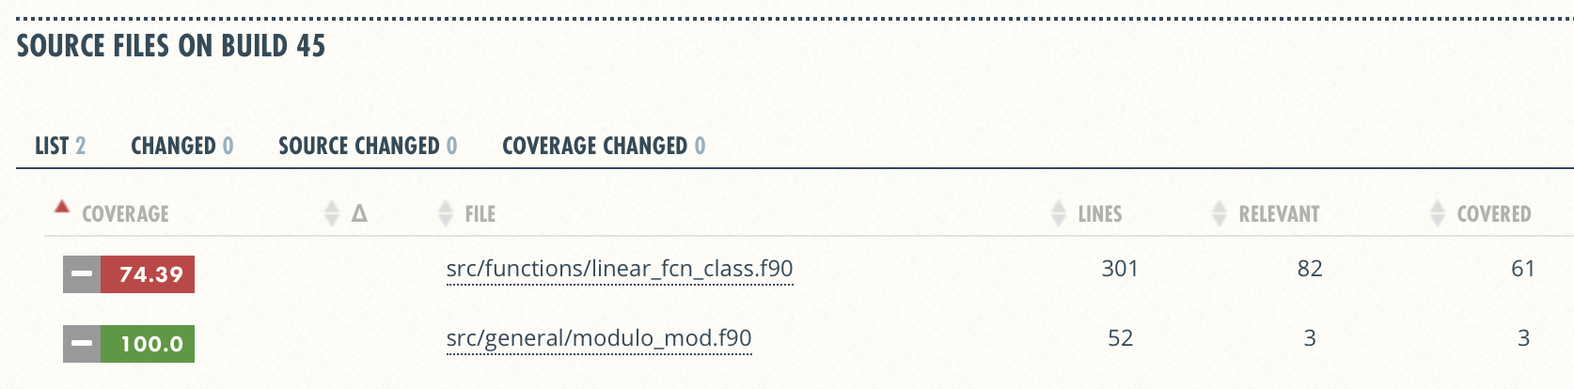
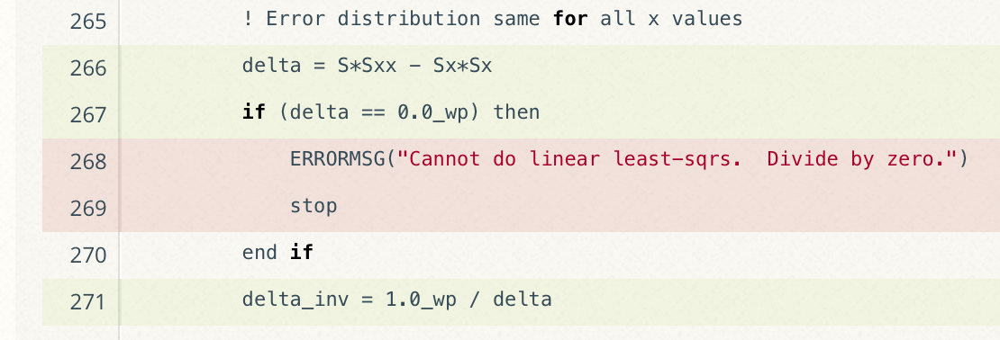
Code coverage output
Overall Analysis
Detailed Analysis
Online tutorial - https://github.com/amklinv/morpheus
Other example - https://github.com/jrdoneal/infrastructure
Notes:
Missing testing of edge cases. This might be important!

Slide 18
Code coverage is popular
gcov also works for C and Fortran
Other tools exist for other languages
JCov for Java
Coverage.py for python
Devel::Cover for perl
profile for MATLAB
etc.

Slide 19
The Short & Sweet of Continuous Integration
A master branch that always works
DVCS workflow isolate master from integration environment
Extend workflow to address difficulties of integrating
Minimize likelihood of merge conflict
Detect bugs immediately
Make debugging process quick and easy
Notes:
Limit divergence between feature branch and master branch
Limit likelihood of conflicts and risk associated with resolving these

Slide 20
Work Decomposition
Commit and integrate often
Limit divergence between feature and master branches
Decreased probability of conflict
Conflict resolution is simpler and less risky

Slide 21
Error detection
Test at integration to identify failures immediately
Control quality of code
Isolate failure to few commits
No context switching for programmer
We want a system that
triggers automated builds/tests on target environments when code changes and
ideally tests on proposed merge product without finalizing merge.

Slide 22
Continuous integration (CI)
Has existed for some time and interest is growing
ECP working with Travis CI to adapt for HPC machines
Setup, maintenance, and monitoring required
Prerequisites
A reasonably automated build system
An automated test system with significant test coverage & useful feedback
Builds/tests must finish in reasonable about of time
Ability to bundle subset of tests

Slide 23
Cloud-based CI
Linked to VCS hosts
GitHub & Travis CI
GitLab CI
BitBucket Pipelines
Automated builds/tests triggered via pushes and pull requests
Builds/tests can be run on cloud systems
Test results are reported in repository’s web interface
Can trigger code coverage analysis & documentation build
Run tests on different environments
Notes:
No need to build and maintain a dedicated server.
Jenkins is another option. Not linked to any particular DVCS and can be built on dedicated server. Benefit is that you can often log into machine, setup and test your suite, and update/test new baselines when needed.

Slide 24
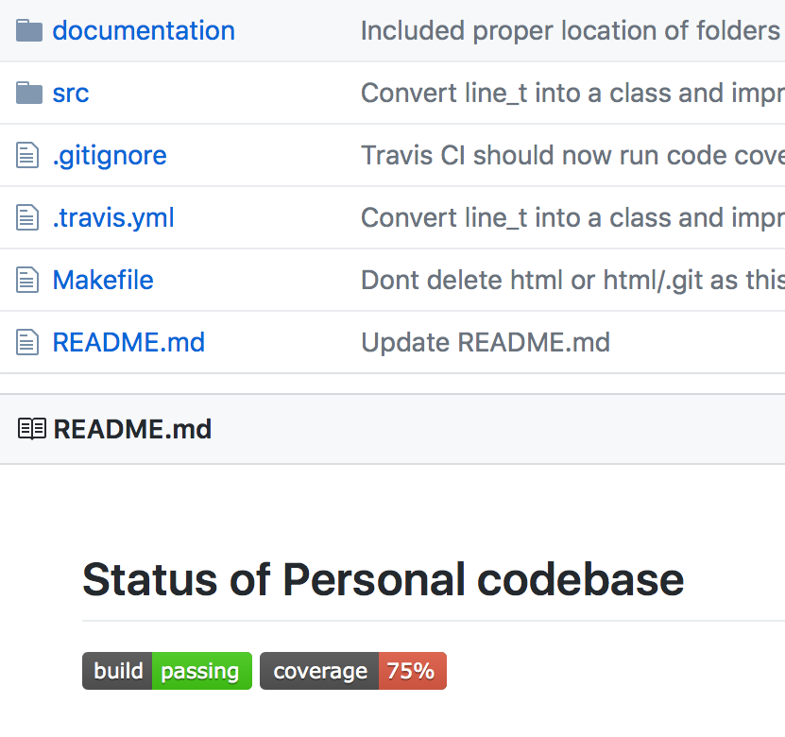
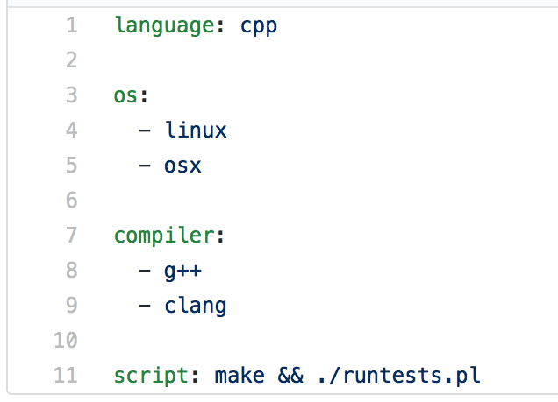
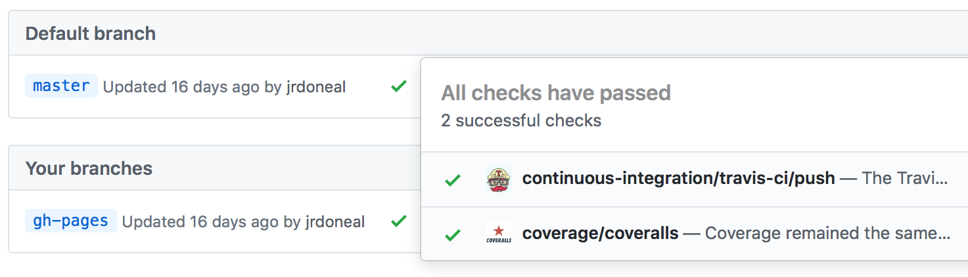
View of toy repository
https://github.com/jrdoneal/infrastructure
Repository Root
Sample .travis.yml
Results of CI Actions
Updated automatically
Notes:
Good online documentation and there are plenty of working examples in GitHub itself.

Slide 25
Putting it all together
Toy CI Workflow
Notes:
Many projects have an intermediate branch such as development that first test on.
Imagine that the refactor work is only done with a small subset of tests related to the code being refactored and that I have run them manually.
The CI would run a small subset of the test suite so that it can finish within my allotted time slot. The automatic nightly tests run the full test suite.

Slide 26
Other resources
Software testing levels and definitions:
http://www.tutorialspoint.com/software_testing/software_testing_levels.htm
Working Effectively with Legacy Code, Michael Feathers. The legacy software change algorithm described in this book is very straight-forward and powerful for anyone working on a code that has insufficient testing.
Code Complete, Steve McConnell. Includes testing advice.
Software Carpentry: http://katyhuff.github.io/python-testing/
Tutorial from Udacity: https://www.udacity.com/course/software-testing--cs258
Papers on testing:
http://www.sciencedirect.com/science/article/pii/S0950584914001232
https://www.researchgate.net/publication/264697060_Ongoing_verification_of_a_multiphysics_community_code_FLASH
Resources for Trilinos testing:
Trilinos testing policy: https://github.com/trilinos/Trilinos/wiki/Trilinos-Testing-Policy
Trilinos test harness: https://github.com/trilinos/Trilinos/wiki/Policies--%7C-Testing

